Slide 1


“It’s Our Teams Passion to Promote Innovative Solutions for Healthier & Safer Indoor Air Quality”
Meet our Julius Toth our Founder eco inventor and IAQ expert. After 40 years of product development combined with marketing excellence, Julius led his team on a path to record success. His award-winning invented better eco-products are used by million to improve the quality of living life indoors.
The PANDEMIC unleased a NEW surging awareness of breathing untreated indoor air. Julius and his expert team create dynamic awareness to todays Optimal Air Solutions. Our family of Advanced AIR Technologies are lab certified to Destroy COVID19 by 99.02% in 30 seconds.

Slide 2


Clean Purified Air is Crucial for Our Student Success
Safe Air™ Benefits
Children are particularly vulnerable to toxic air contaminants.
Not only are their breathing rates higher in relation to their body weight, but their lung development is also directly affected by air pollution.
Exposure to polluted air during these developing years leads to decreased respiratory function later in life.
Increasing reports of asthma, which is one of the leading causes of absenteeism among school age children, have been directly linked to elevated air pollution exposure.
Recent data also suggest that poor indoor air quality may directly reduce a person's ability to perform specific mental tasks requiring concentration, calculation or memory

Slide 3
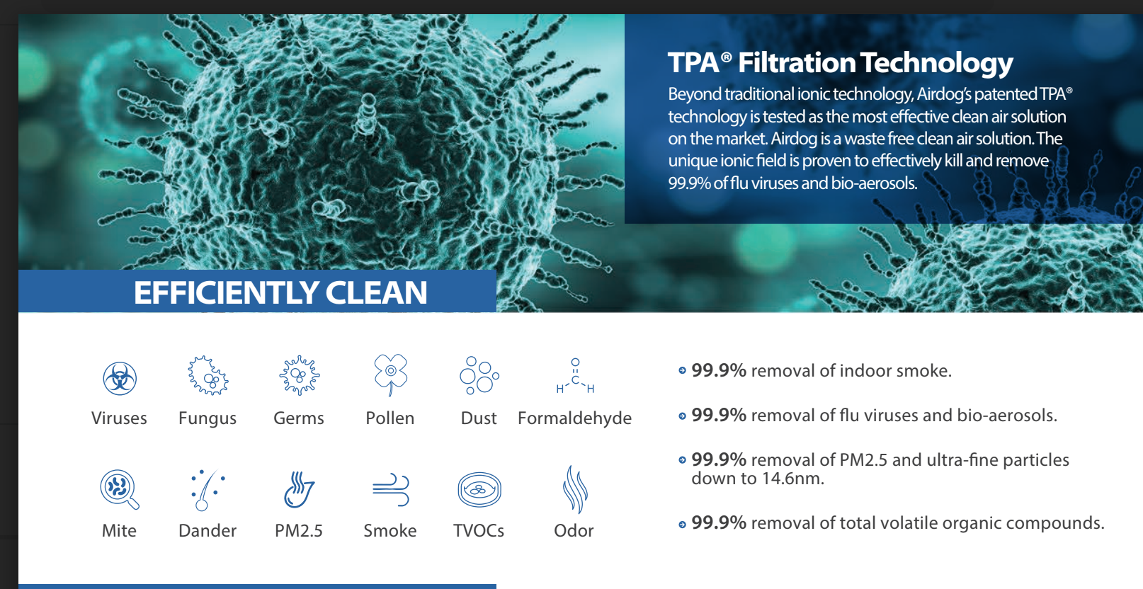

Slide 4
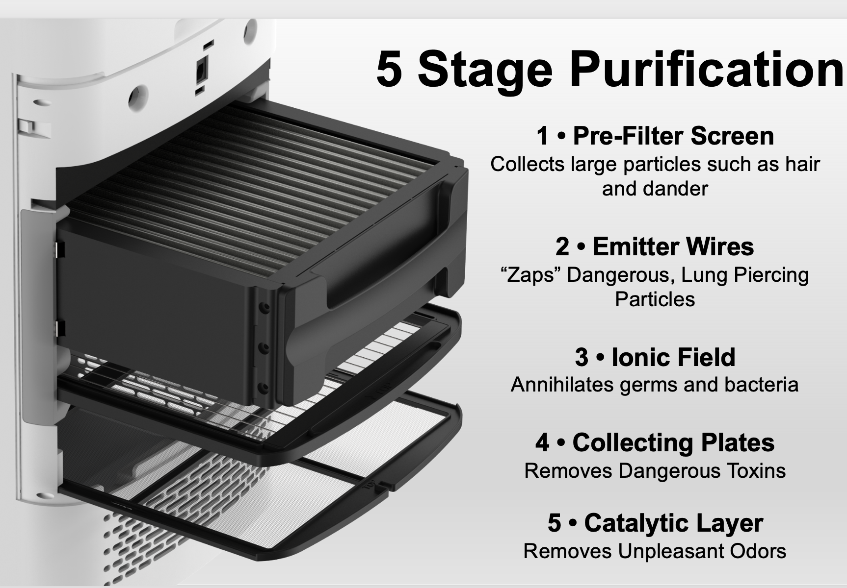
Patented One-Of-A-Kind Clean Room Benefits
Lab Confirmed AirdogRX is the most effective waste-free indoor air solution. Complete with lifetime washable filters
Unlike outdated HEPA , Airdog™ combines purification and sterilization to rid your indoor air of not only dust and allergens, but also infectious mold bacteria and viruses
Trusted Technology, Airdog®advanced technology is the #1 choice of premium institutions such as Texas A&M University, trusted by one million consumers, schools, businesses, gov. facilities worldwide

Slide 5
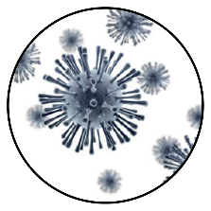
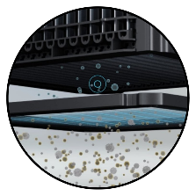
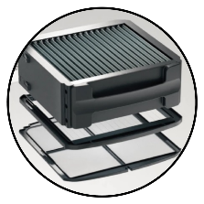
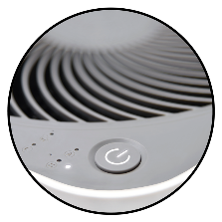
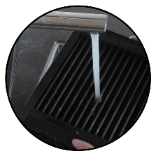
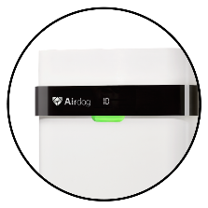
Next Level Patented Benefits and Features
Kills Viruses and More
Removes Influenza, COVID-19 and other biological contaminants.
Record Breaking
Destroys particles down​ to ​
14.6 nanometers in size.
Outperforms HEPA
Unique filter design not only
collects but destroys pollutants.
Whisper Quiet
Operates nearly 6 times
quieter ​than other purifiers.
Waste Free Design
Requires no expensive
filter replacements.
Built-In AQI Sensor
Test the real time air quality
of your space.

Slide 6
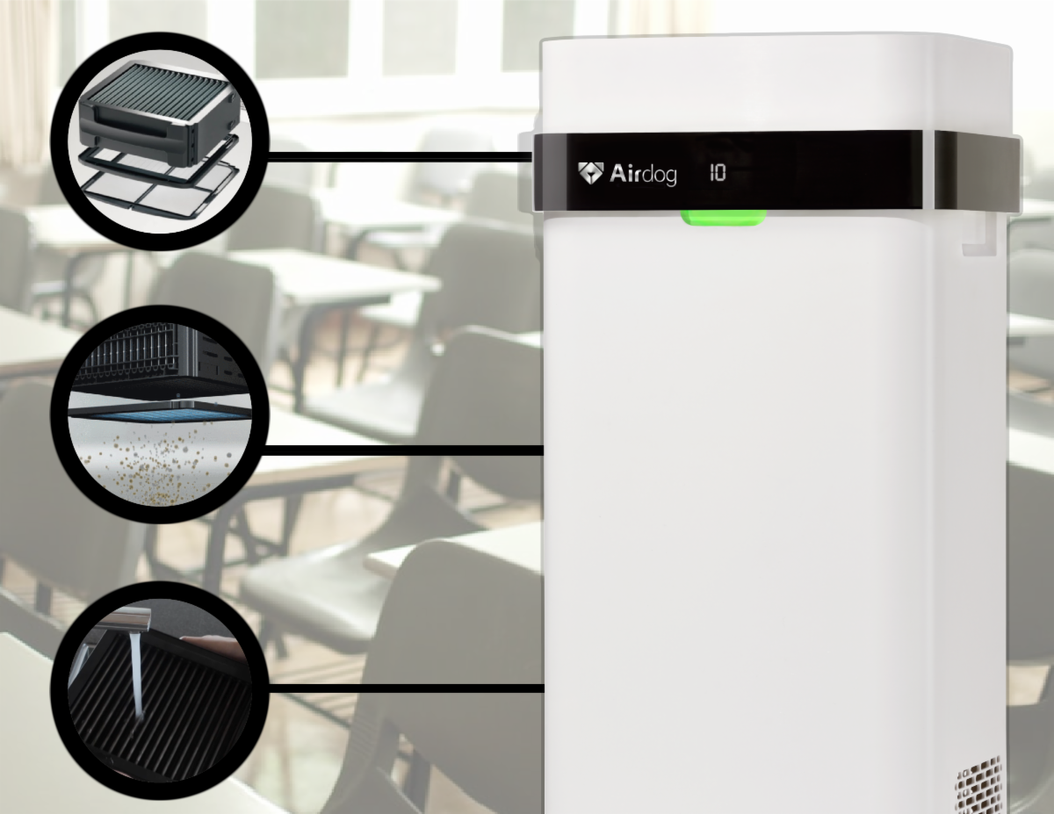

Patented Benefits Destroys COVID19 Virus Annihilates all infectious germs & viruses, including over 99%.02 in 30 seconds Outperforms HEPA at 0.3 Micron HEPA AirdogRX technology collects and destroys Worst Air Allergens Removes nanoscale microscopic pollutants to 14.6 nanometers Washable Filtration Requires no expensive filter replacements 6X Quieter than most Air Quality Monitor HVAC Available

Slide 7
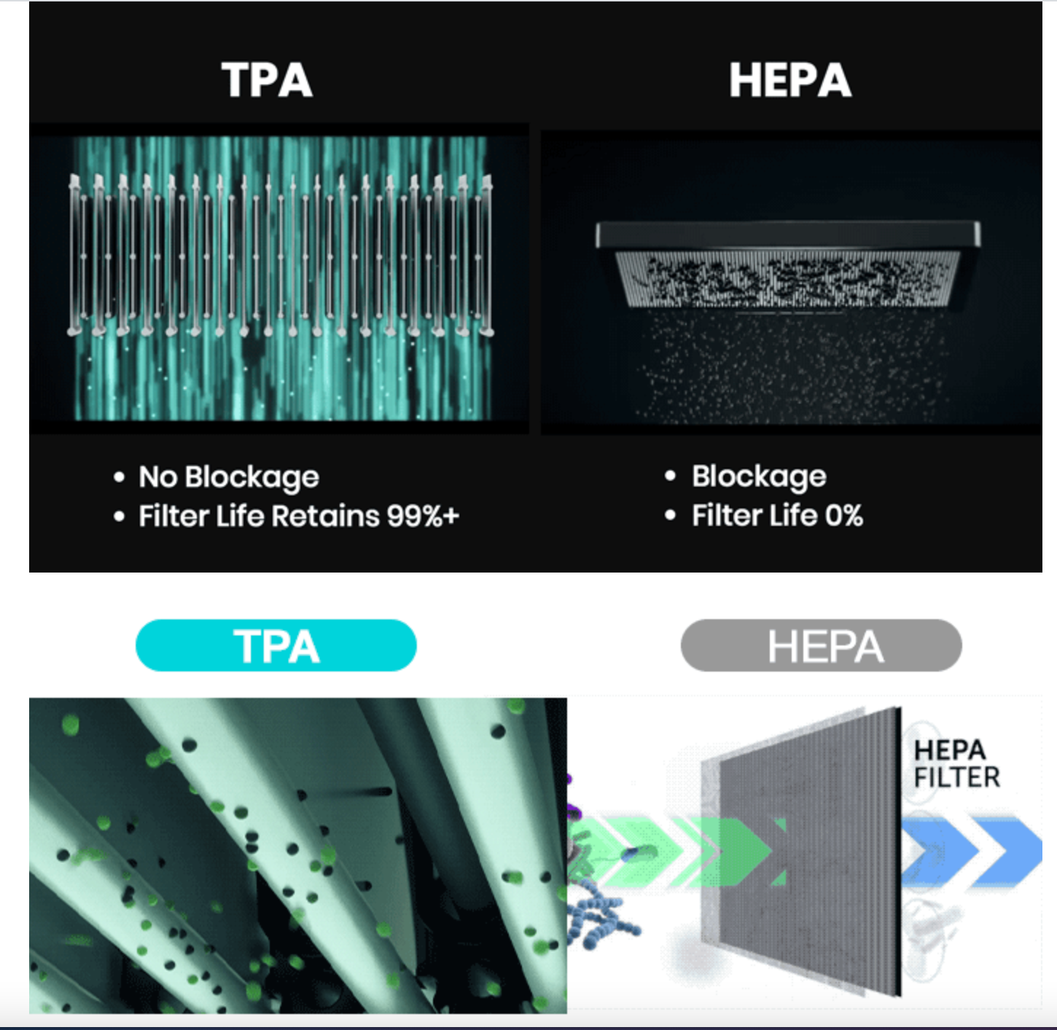
Outdated HEPA uses problematic porous filters. As filter pores plug cleaning efficiency drops instantly. HEPA filters can overflow with dangerous pollutants

Slide 8
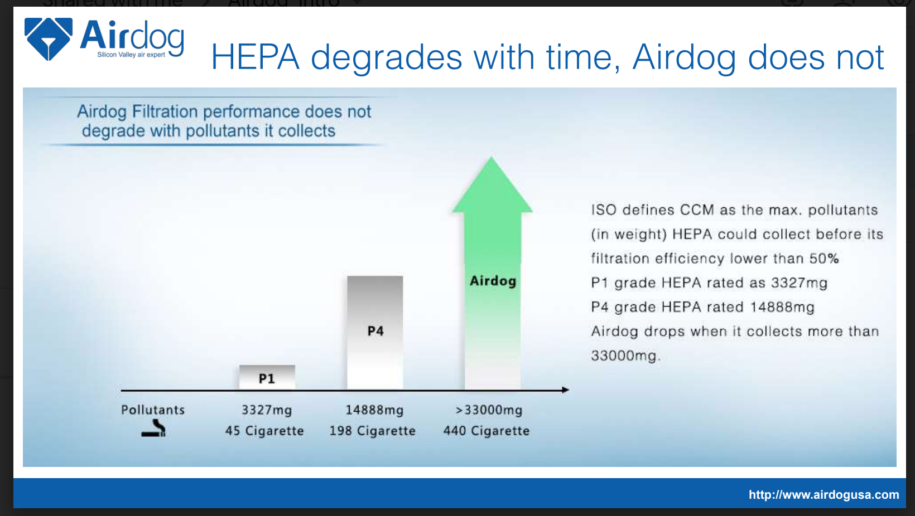

Slide 9
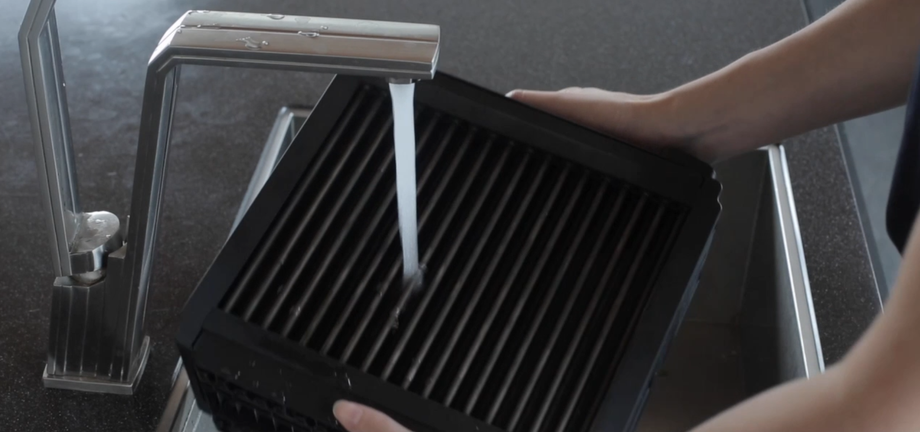
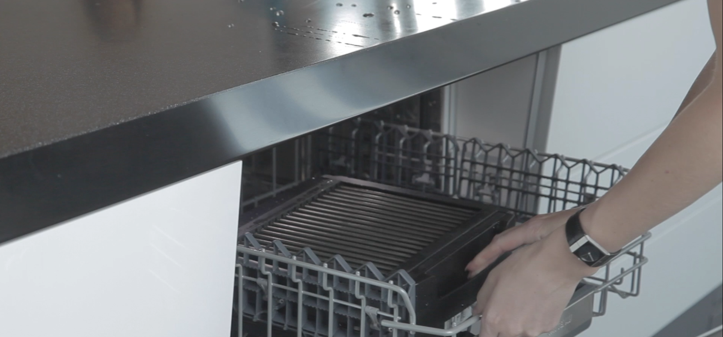
Imagine an Air Purifier that Requires No Filter Replacements…
HEPA air purifiers will often stop working when the filter isn’t changed regularly. Pollutants that were once collected can escape back into the air you breathe.
​Don’t spend another dime on expensive filters that need to be replaced each month. With Airdog's reusable, easy to clean collecting plates, you will save time, money, \

Slide 10
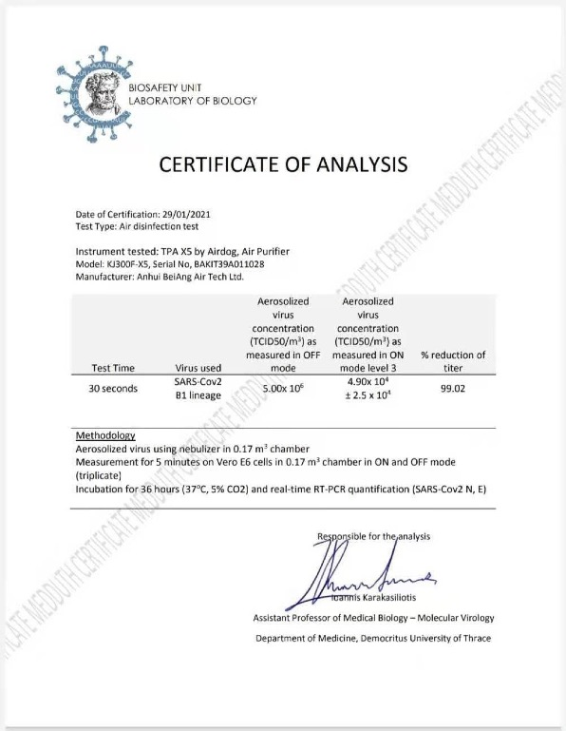
Lab Certification
CONFIRMS
Air X Technology Kills COVID 19 including all known flu viruses

Slide 11
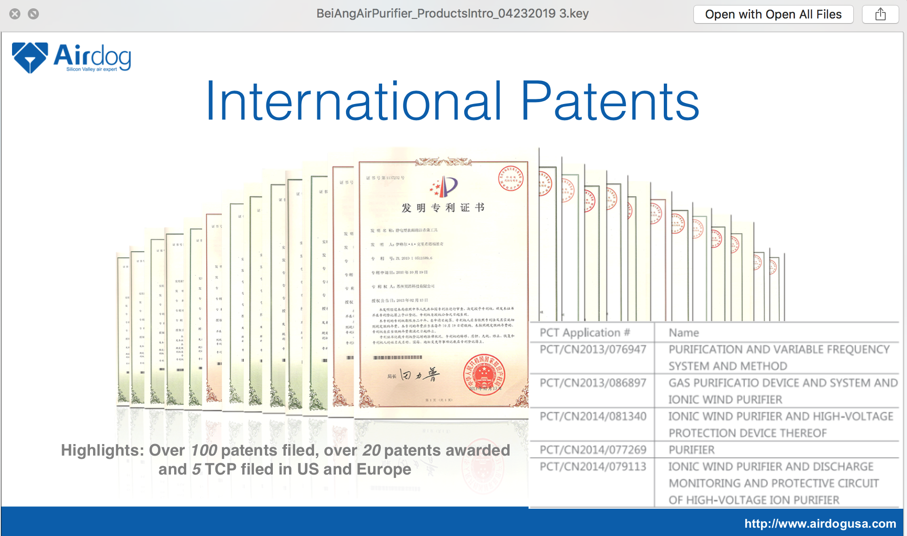

Slide 12

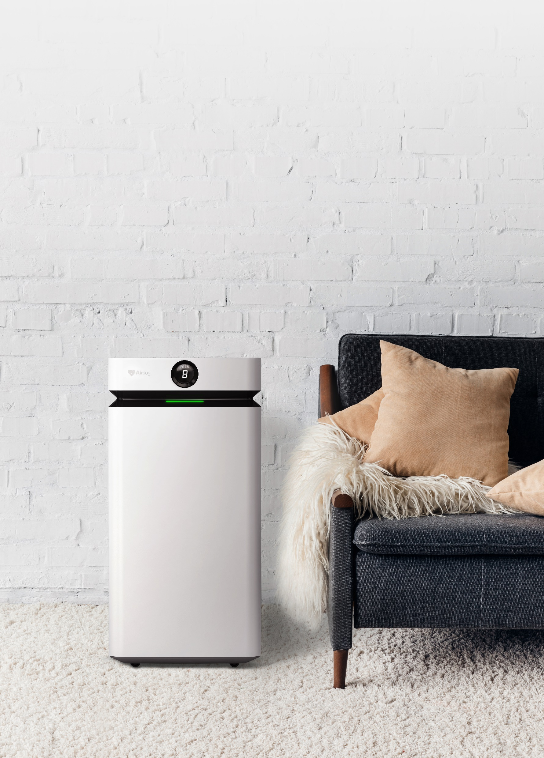
X8
Your Ultimate Pollution Solution
Introducing the Airdog X8
The Airdog™ X8 is the fastest and most powerful Airdog™ product for superior air purification. By moving polluted indoor air through its filtration quickly, Airdog™ X8 can clean the air of a 1000 square foot space in just 20 minutes – making it the ultimate choice for large spaces.

Slide 13
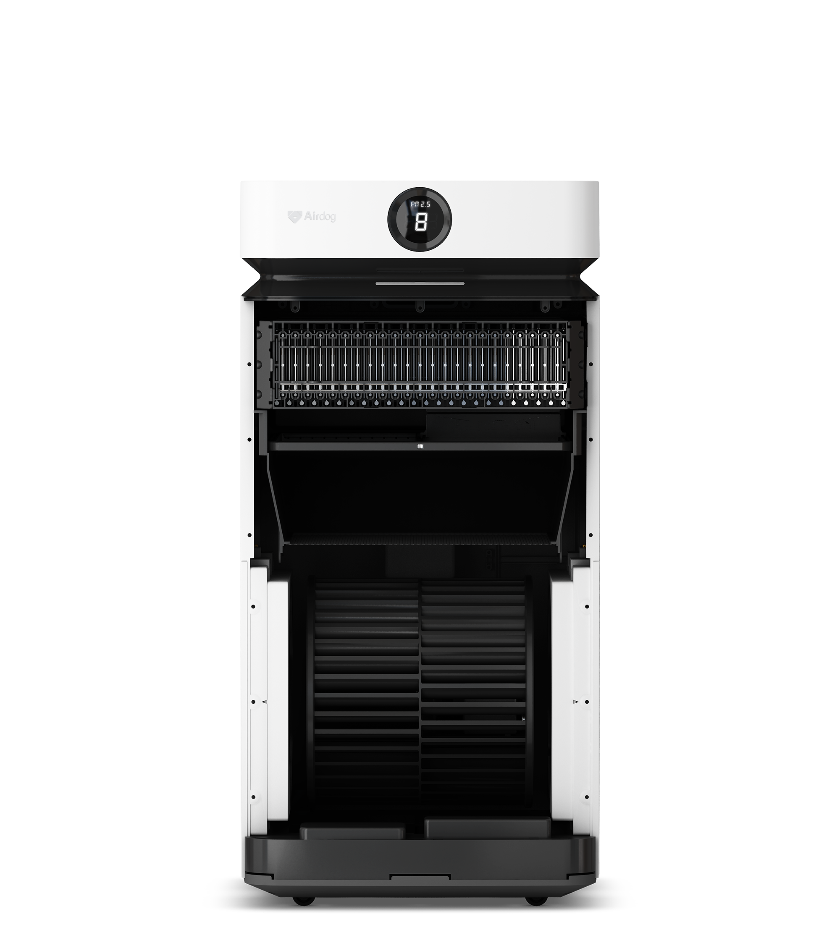
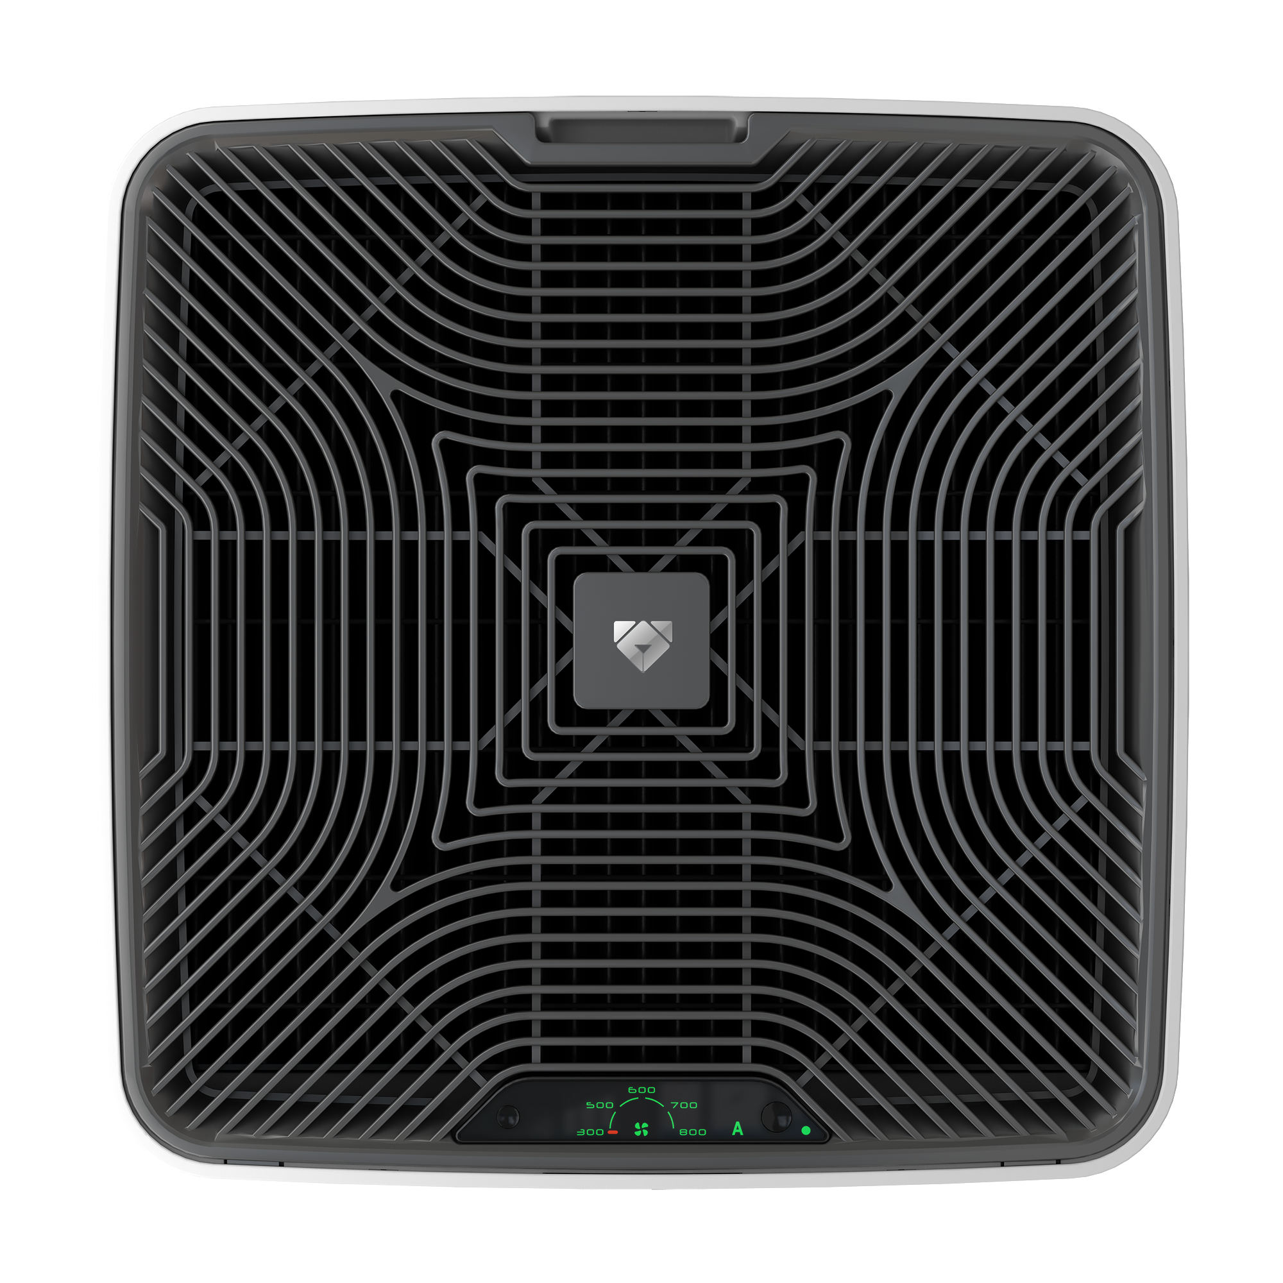
Fast & Powerful -
Airdog™ X8’s CADR (Clean Air Delivery Rate) reaches up to 470 cubic feet per minute – making it a leader in air purification for airflow speed to destroy pollutants in the air and create a safe breathing zone
Quiet -
Airdog X8 takes aerodynamic design to a higher level. You won't find another air purifier that is quieter than the X8. When comparing products at the same airflow rate, the noise level of 8 Airdog X8's working together equals the noise level of one of our competitors' units!

Slide 14
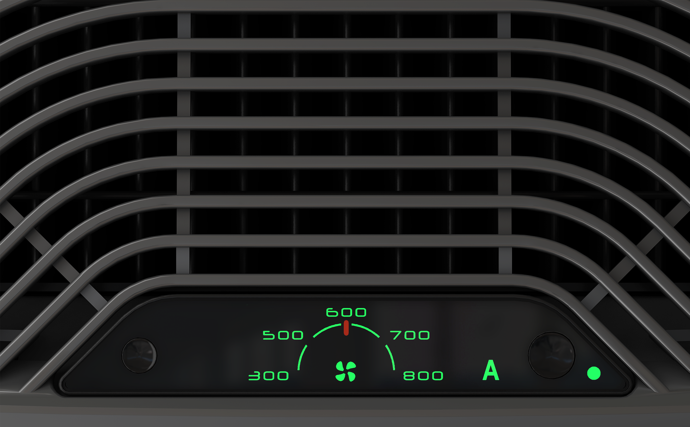
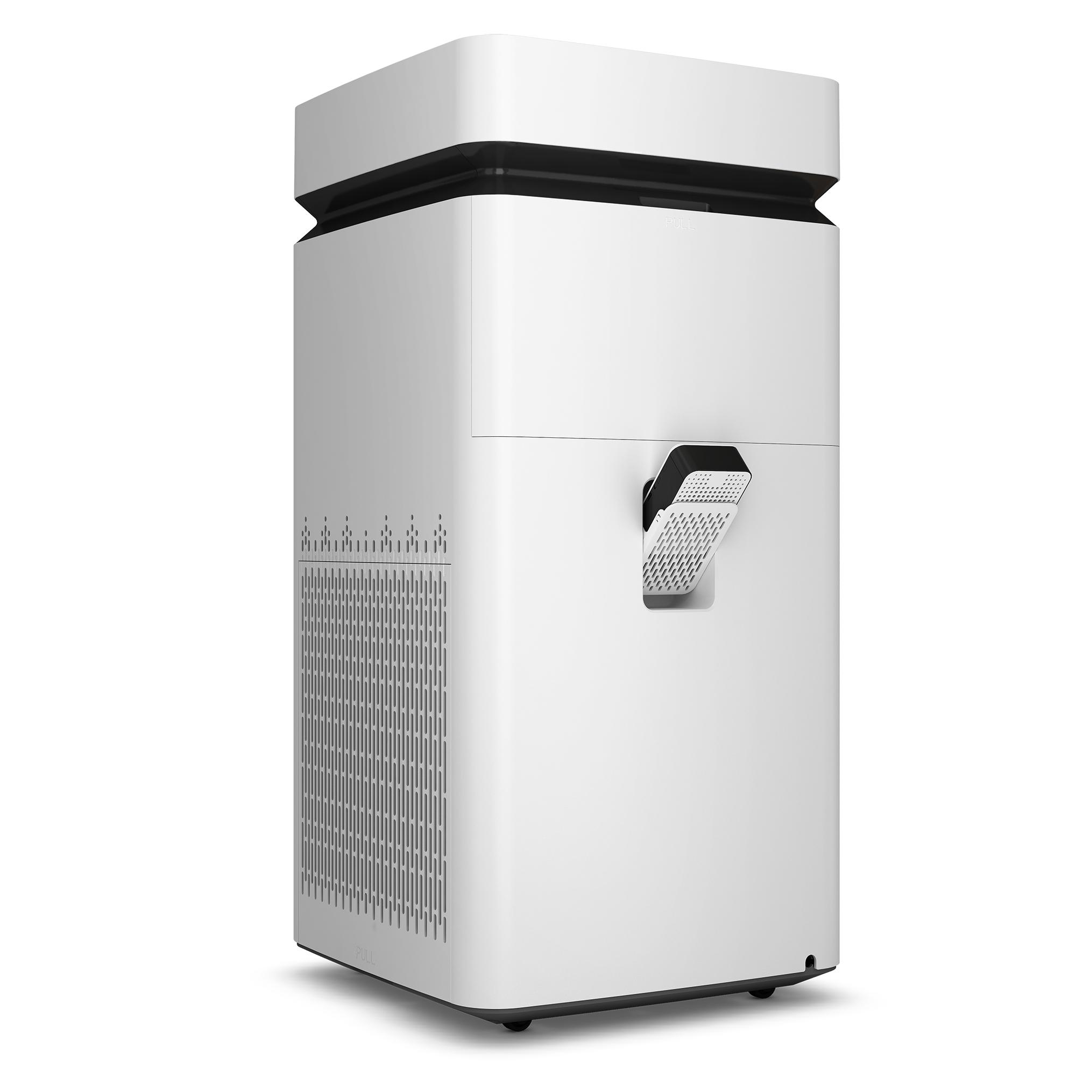
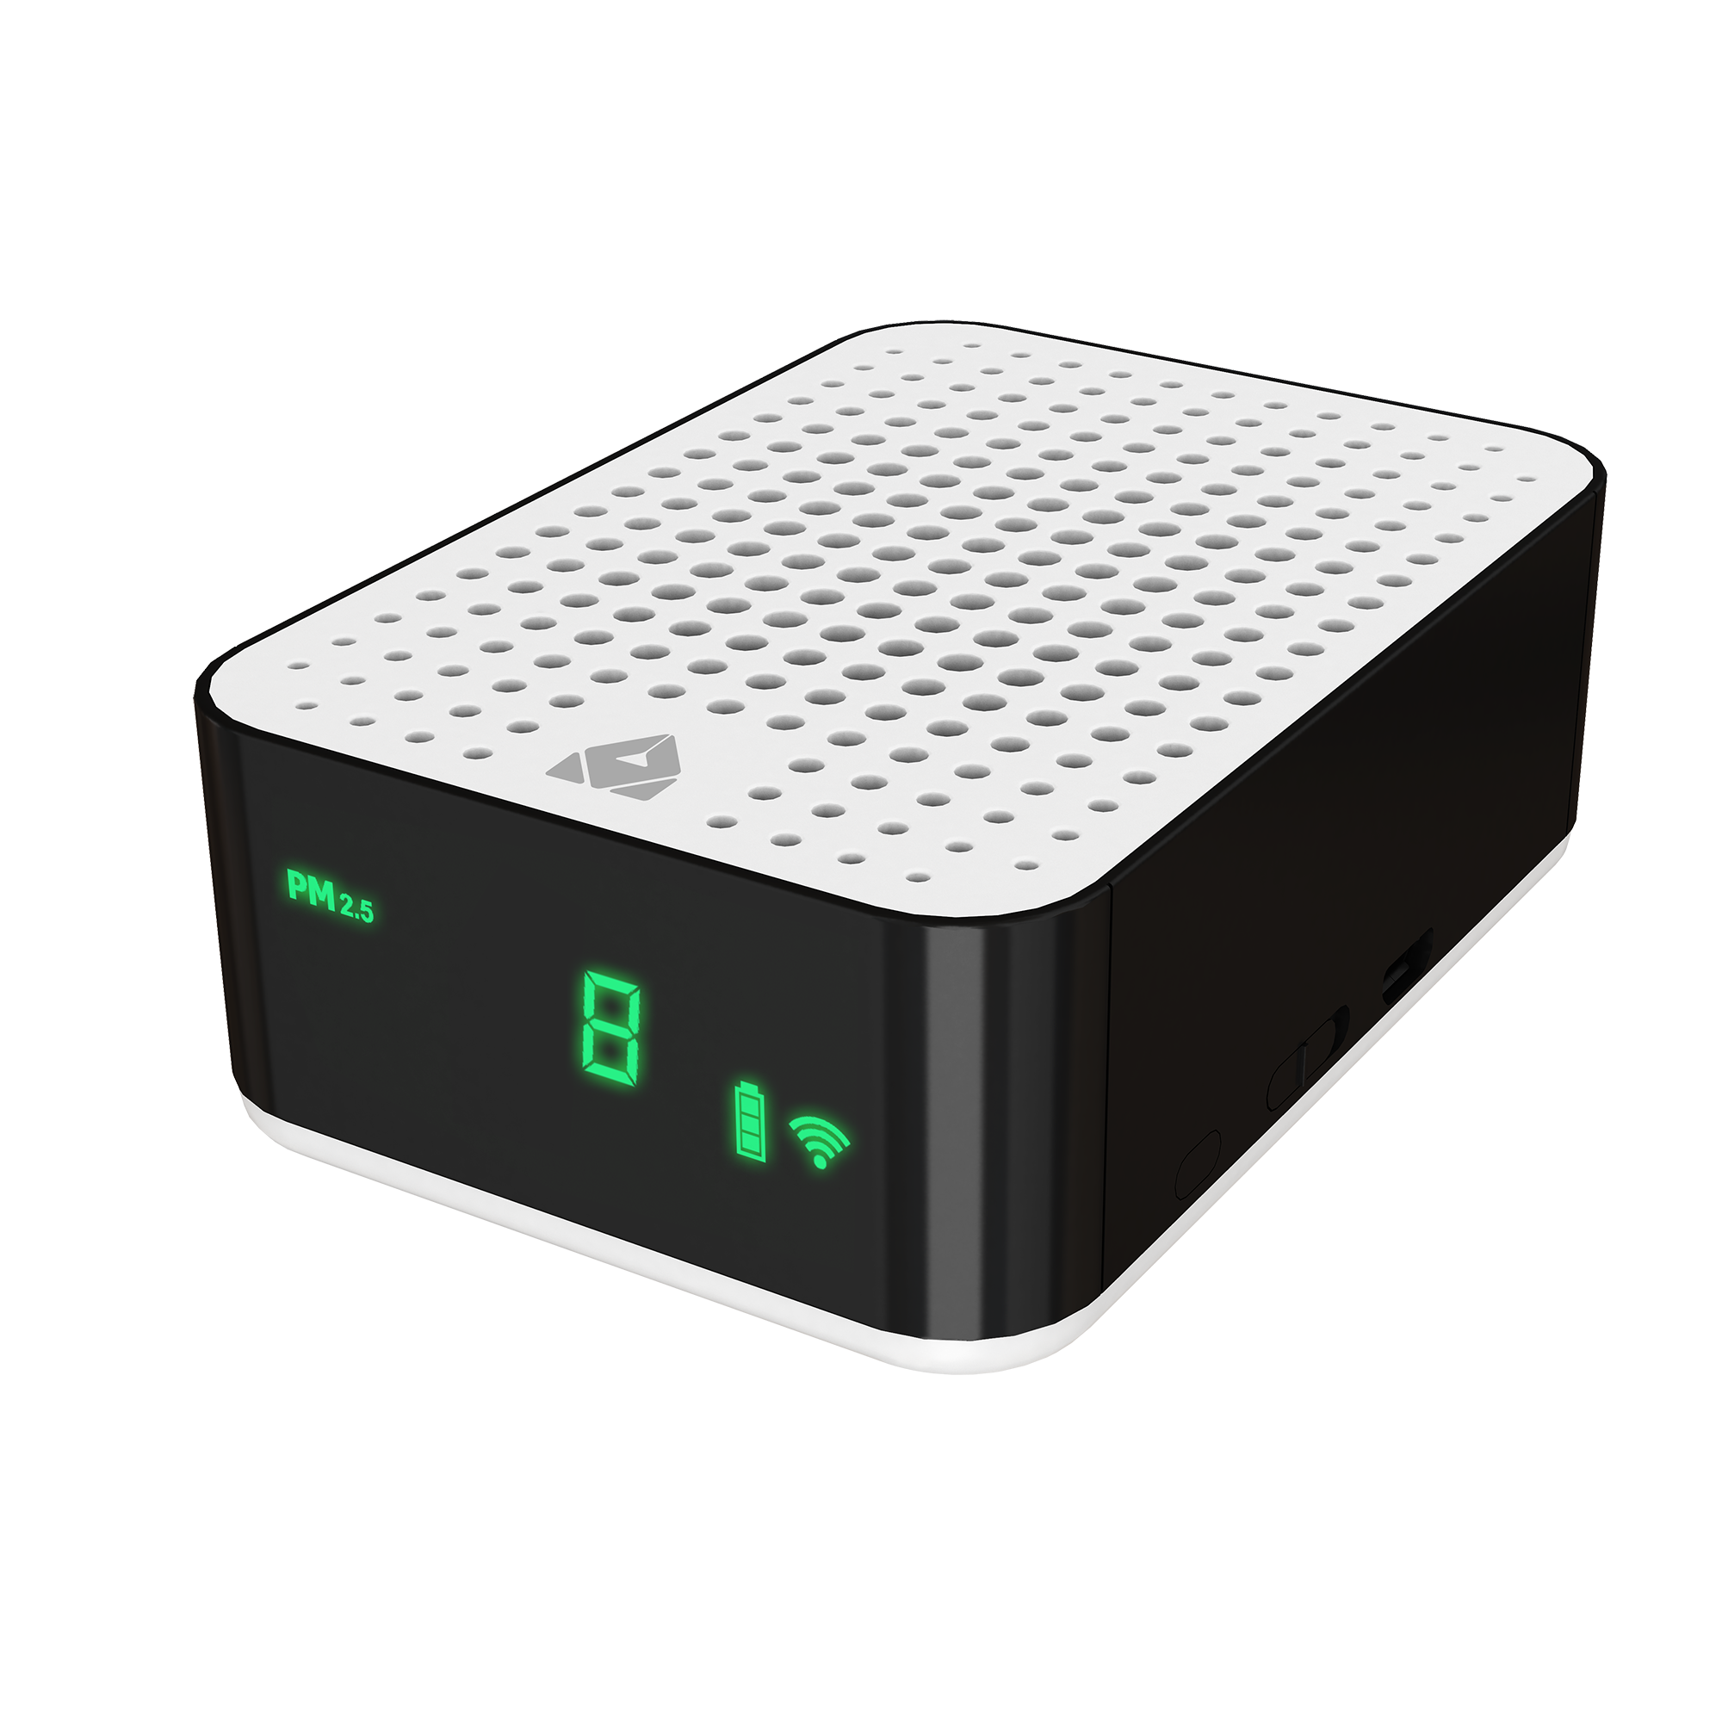
Detachable Air Quality Meter –
Housed inside the unit, the air quality sensor tests air quality and adjusts as needed to clean air. You can also remove the sensor and place it in another part of the room.
Real Time Monitoring –
A simple glimpse at your X8 model allows you to see the current state of your room’s air. Green is excellent, light yellow is good, yellow is moderately polluted, and red is hazardous air conditions.

Slide 15
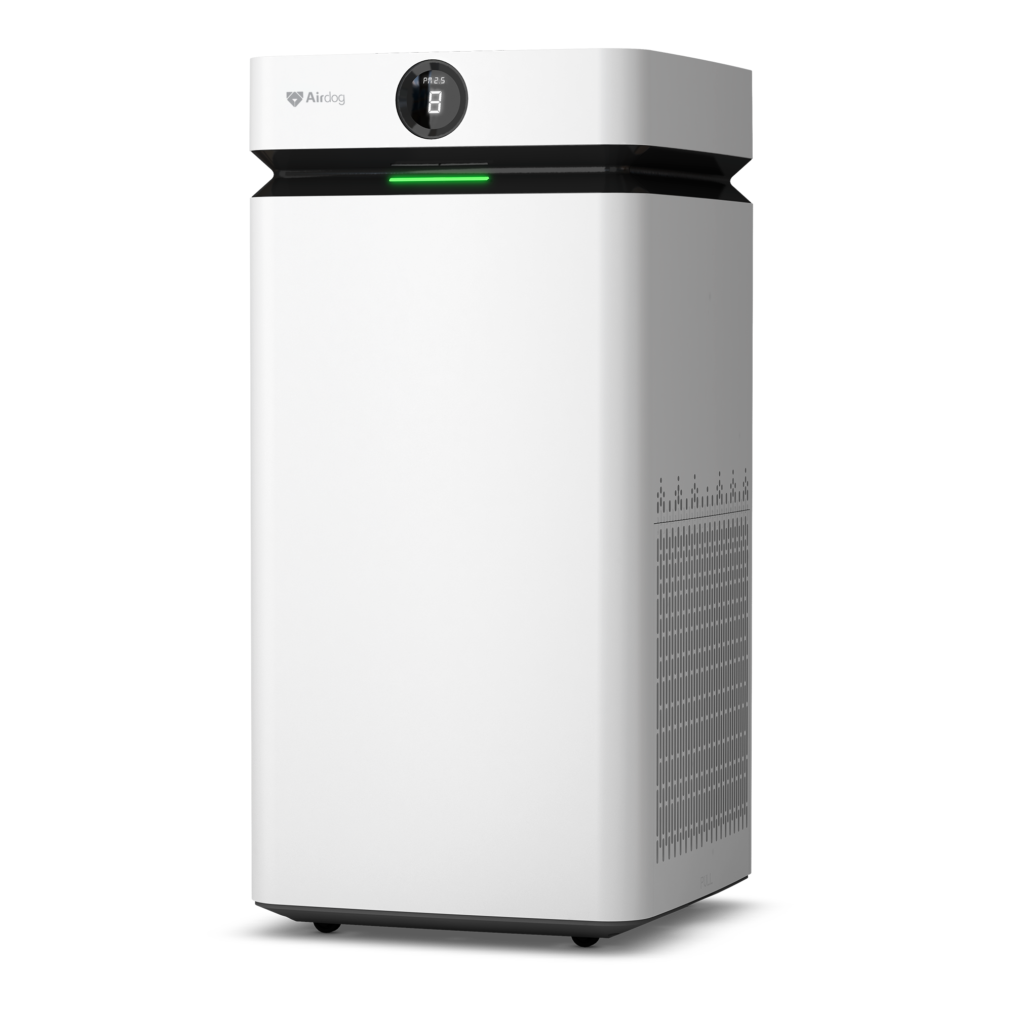
Airdog X8 Specifications
Model – KJ800F-X8
Applicable Area - 3000 square feet / hour
Noise Level (dB(A)) - <63
Rated Power (W) – 110
Rated Voltage – 110V~
Rated Frequency – 50/60 Hz
Size – 30 x 15 x 15 inches
Weight - 43.5 lbs

Slide 16
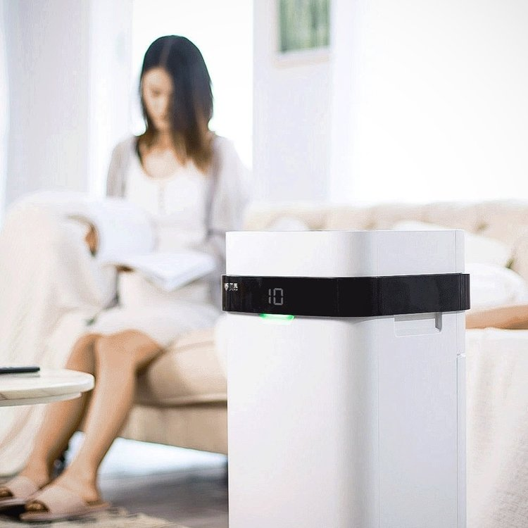
X5
The Original Airdog Design
– Now New and Improved!
Airdog X5 is the original design and best seller of the product line. X5 implements patented TPA technology to purify up to 1400 square feet in just 1 hour. Airdog X5 is a perfect addition to maintain a safe breathing zone in a variety of places and spaces.

Slide 17
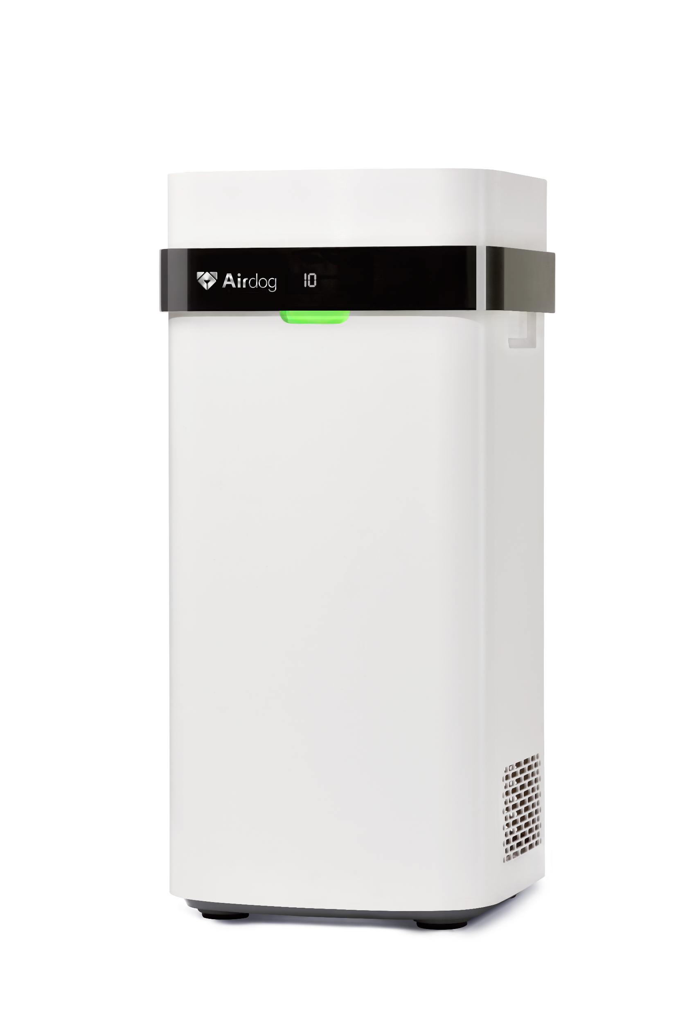
Specifications
Model – KJ300F-X5
Applicable Area - 1400 Square Feet / Hour
Noise Level (dB(A)) - <63
Rated Power (W) – 55
Rated Voltage – 100-240 V~
Rated Frequency – 50/60 Hz
Weight – 23 lbs

Slide 18
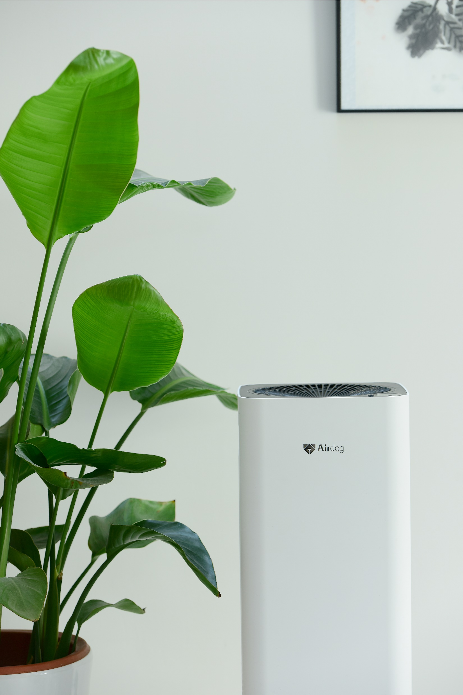
X3
Small, but Mighty –
The Exclusive Airdog X3
​Smaller Space, Smaller Price,
Same Great Technology. Airdog™ X3 is a compact, clean air solution - purifying 800 square feet in just one hour. Perfect for bedrooms or other small living spaces.

Slide 19
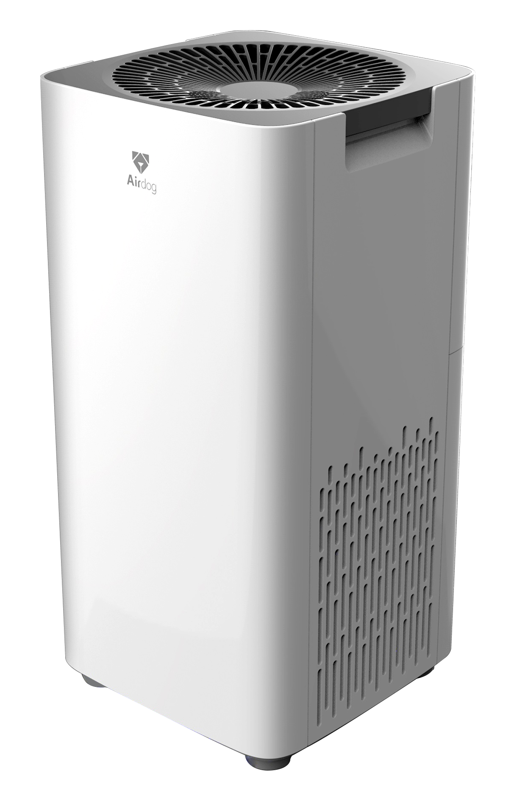
Airdog X3 Specifications
Model – KJ200F-X3
Applicable Area - 800 Square Feet / Hour
Noise Level (dB(A)) - <58
Rated Power (W) – 27
Rated Voltage – 100-240 V~
Rated Frequency – 50/60 Hz
Size – 20.5 x 10.2 x 10.2 inches
Weight – 11 lbs

Slide 20
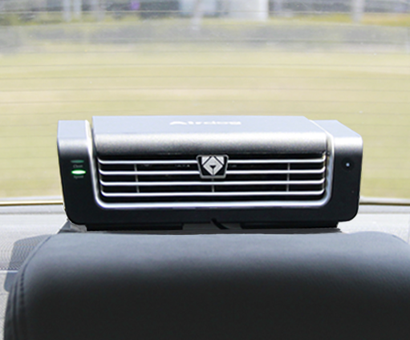
V5
Compact Air Purification –
Perfect for cars, offices and
other small spaces
Originally created as a car purifier, Airdog™ V5 is compact and lightweight - move it from your vehicle to your office or other small space with ease & keep your breathing zone free of bacteria, allergens and pollutants!

Slide 21
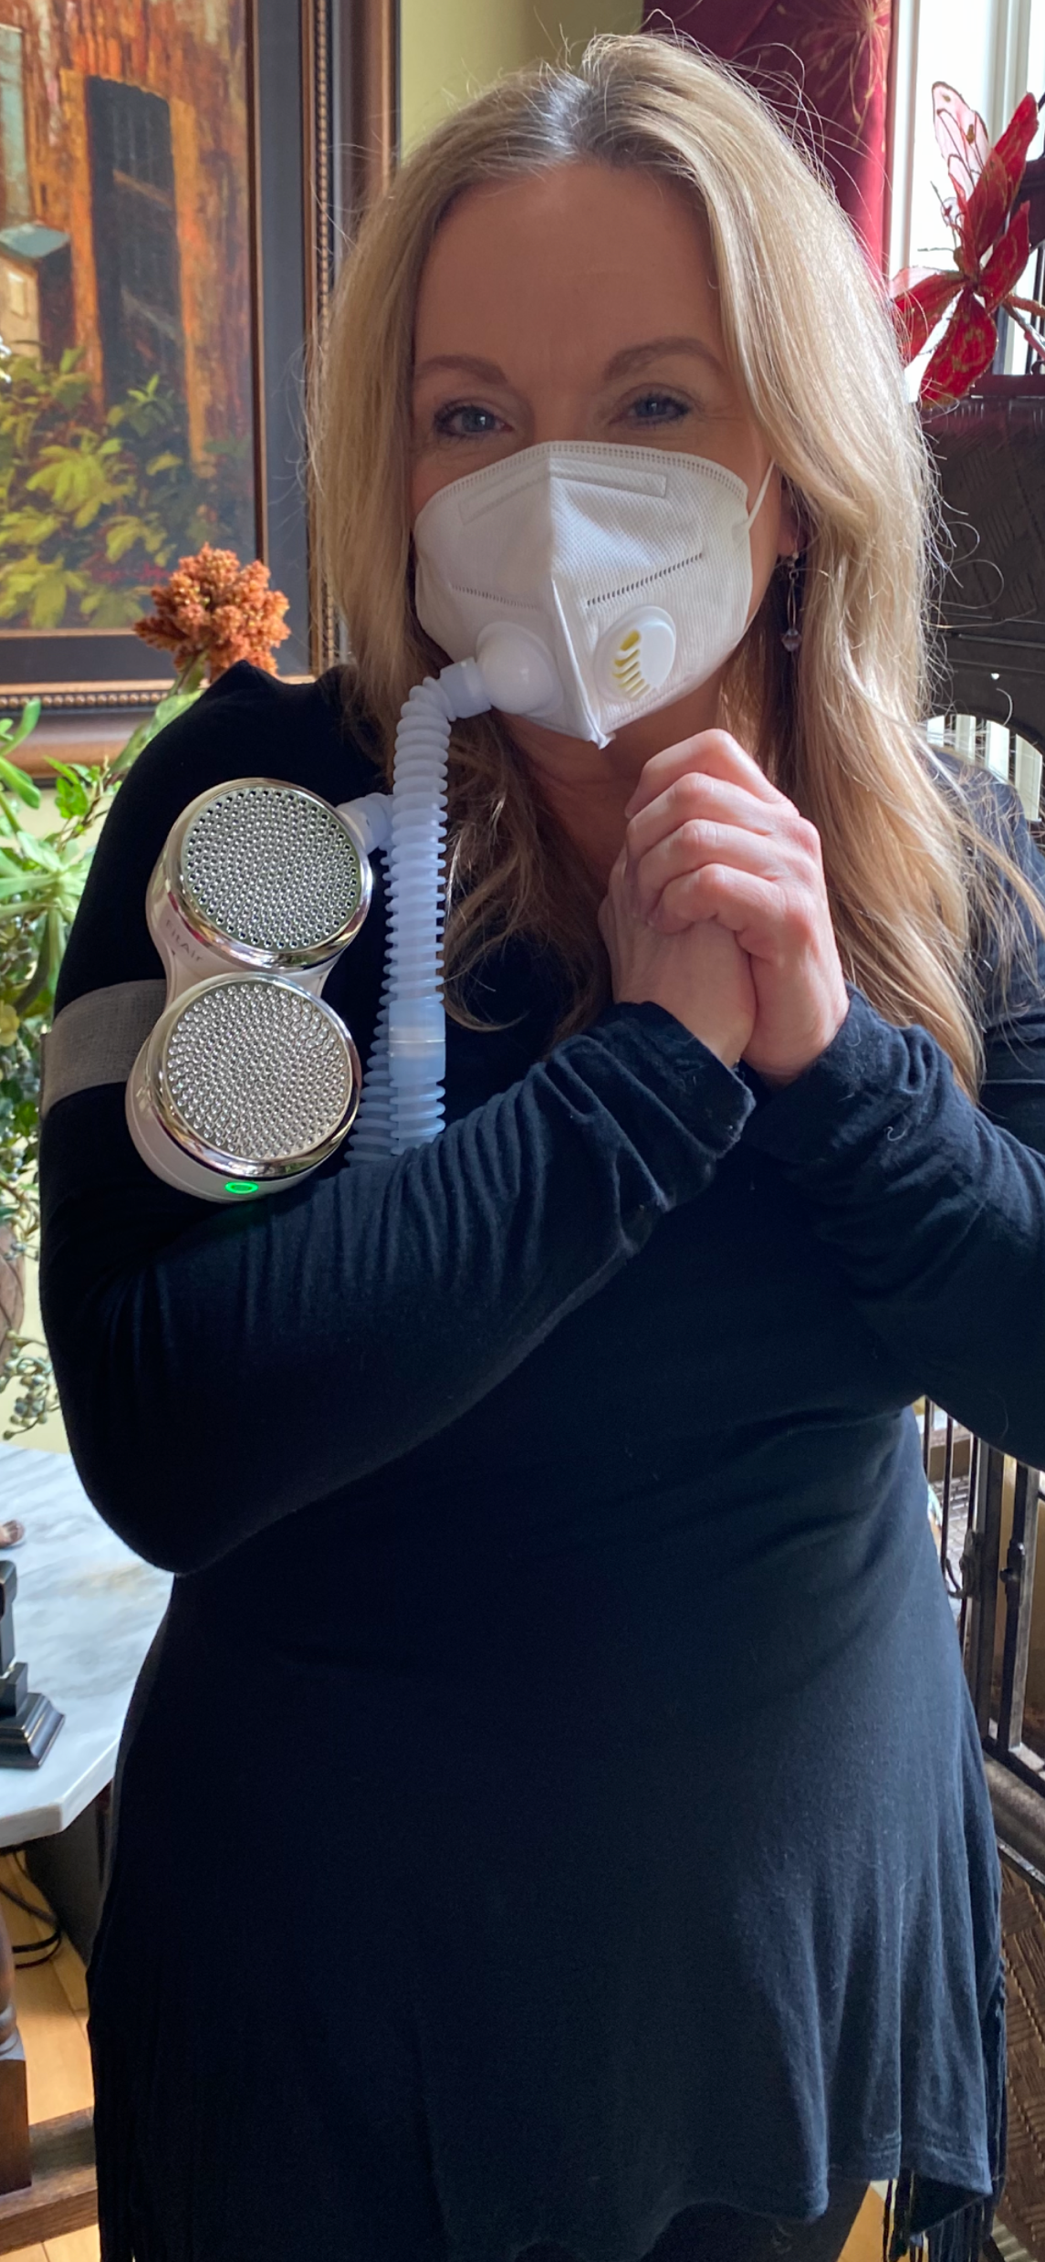
FitAir
Your On-the-Go Solution -
Protect Your Breathing Zone
FitAir by Airdog™ is the one of a kind wearable solution that improves your health by freeing your air of viruses, smoke, bacteria, allergens and other harmful pollutants.

Slide 22
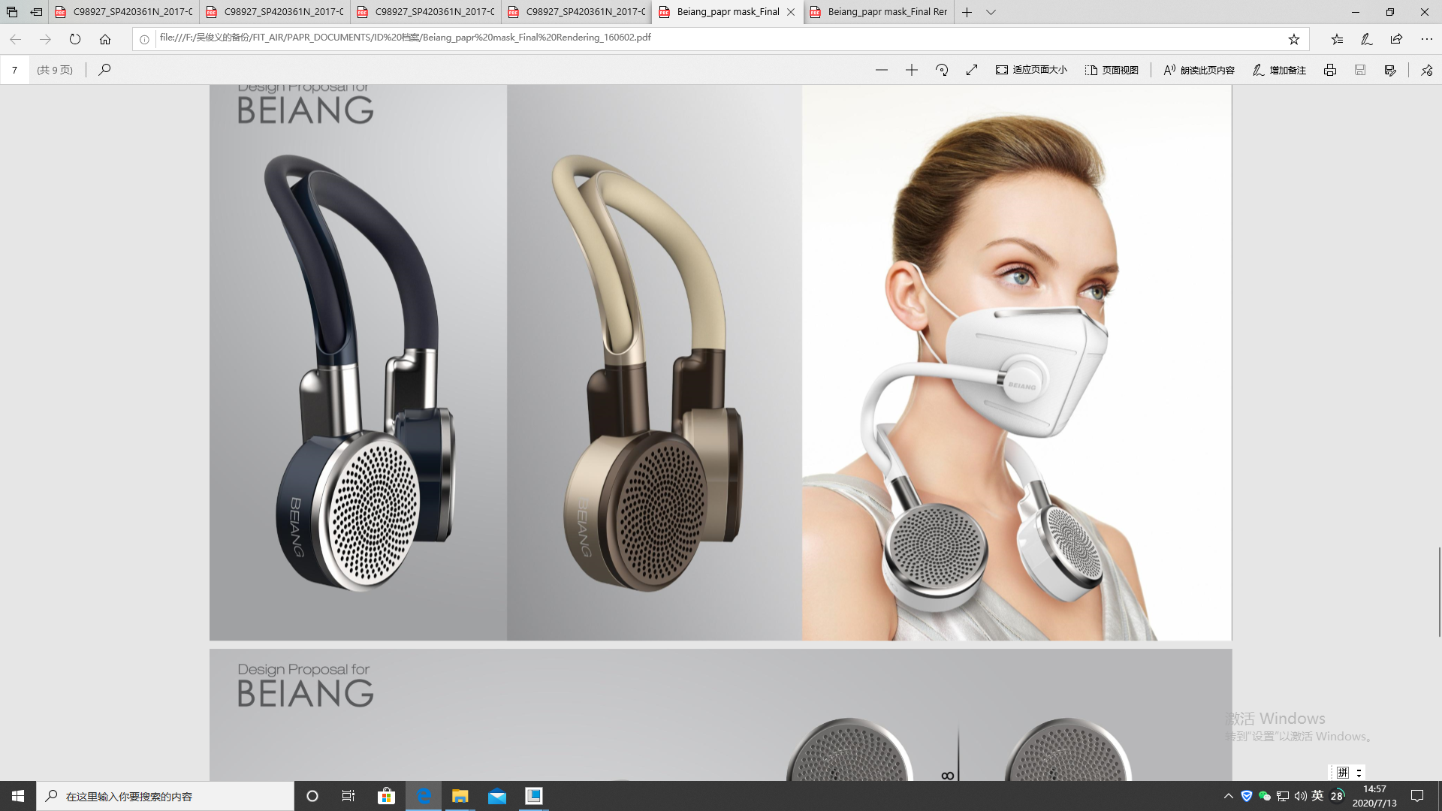

Slide 23

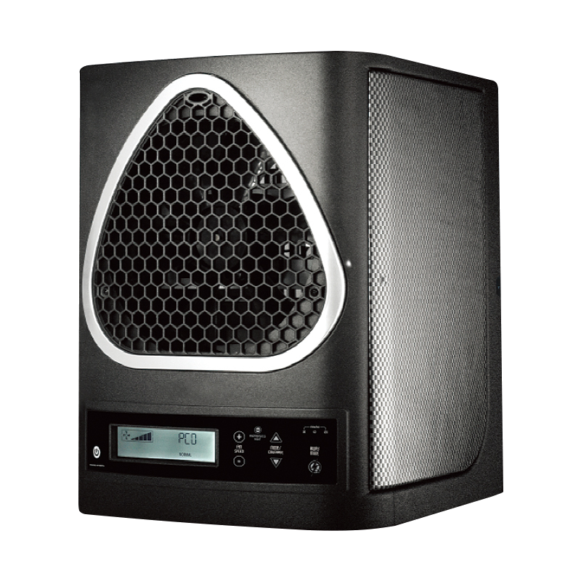
SafeAir™ powered by NASA inspired OptiPURE™ technology works with 4proven technologies replicating our Earth's most effective cleansing molecules that rapidly transform any space into a safe breathing zone.
Imagine unleashing the power of a refreshing and revitalizing "thunderstorm in a box" to sanitize and purify your living or workspace for safer, healthier and more vibrant indoor living experience.
You no longer need to step outside for a "breath of fresh air," experience it everyday all day long with SafeAir!™

Slide 24

What is OptiPure™
Technology?
NASA inspired OptiPure™ Technology produces the world's most powerful, yet 100% safe, sanitizing molecules proven to rapidly oxidize organic materials, odors, mold and even infectious viruses!
First discovered and used by NASA, OptiPure™ unleashes a blend of TIO2, activated oxygen and healthy negative ions that will sanitize and protect up to 3,000sq/ft in your home or business.

